Slide 1


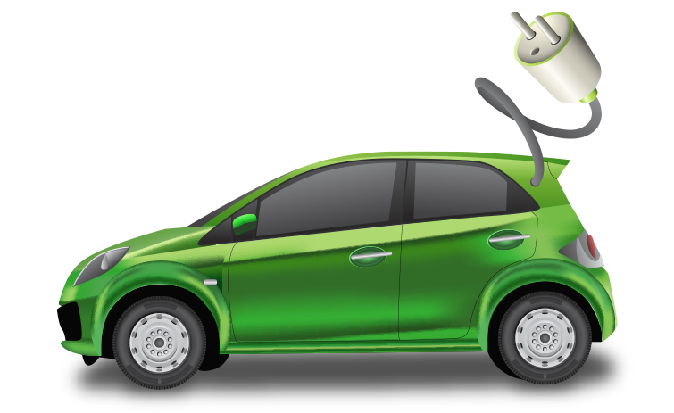
Ideathon 2024
Transparent Decision-Making for Electric Vehicle Routing:
Integrating DRL, GNN, and XAI
A Comparative Study of DRL Models with GNN and Explainable AI for Electric Vehicle Routing Optimization
Dimeth Nouicer; Elie N. Mulamba; Imen Habibi; Jérémie N. MABIALA; Mame Diarra Diouf; Souleymane Diallo
Notes:
Hello everyone. It’s a pleasure to be here at the Ideathon 2024.
So our research idea is Transparent Decision-Making for Electric Vehicle Routing.
Together with my colleagues—Ellie, Imen, Jérémie, Mame Diarra, and Souleymane
we want to conduct a comparative study of different models using RL, GNN and XAI techniques combined together to address these routing challenges.
—---------------------------------------
Helloo everyone it’s a pleasure to be part again of ideathon indaba 25 as one of the winners of last year ideathon ….our idea is a research paper about transparent decision………..
Together with my colleagues—Ellie, dimeth, Jérémie, Mame Diarra, and Souleymane
we want to conduct a comparative study of different models using RL, GNN and XAI techniques combined together to address these routing challenges.
:

Slide 2

Reinforcement Learning (RL) and Decision-making
Decision 1
Final solution
Decision n
R
Sequence of decisions
P
…
D
A
Decision 2
Solve complex sequential decision-making problems
Notes:
RL, has emerged as a powerful approach to solving complex, sequential decision-making problems.
each decision an RL agent makes affects the next decision and so on.

Slide 3
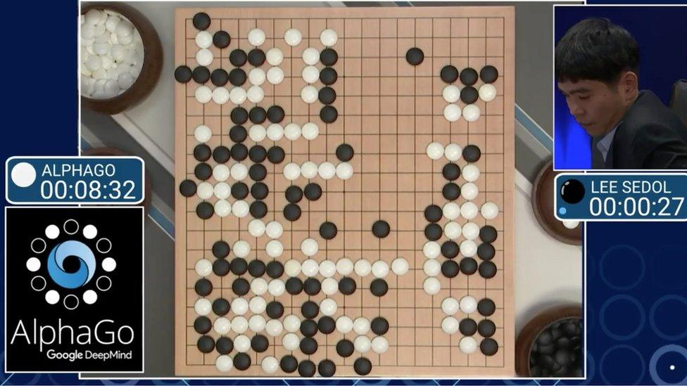
Reinforcement learning
Decision 37
Decision 1
Turned the course of the game in AlphaGo’s favour
Final solution
AlphaGo’s Victory
…
Decision 2
AlphaGo’s second challenge against Lee Sedol (ranked 9-dan)
Notes:
A famous example that illustrates the potential of RL is AlphaGo,
the AI that famously defeated the world champion Go player, Lee Sedol.
AlphaGo excelled at this because Go, like many real-world problems,
is about making decisions over time, considering not just the immediate consequence but also the long-term impact.
However, during AlphaGo’s second challenge against Lee Sedol, AlphaGo made its now-legendary 37th move
—a decision that surprised both commentators & Lee Sedol
It was a creative, unpredictable move that shifted the game in AlphaGo's favor.

Slide 4
Reinforcement learning and interpretability
Decision 37
Decision 1
surprised both commentators & Lee Sedol
Final solution
Victory
…
Decision 2
David Silver, DeepMind researcher, reportedly had no insight into why AlphaGo made such a creative move until he had investigated the actual calculations made by the programme [2]
Operate as a black-box
Lack of interpretability
Notes:
This brings us to a critical issue: as effective as RL models can be,
they often function like 'black boxes,'
making decisions that are not easily interpretable to human users
David Silver, DeepMind researcher, reportedly had no insight into why AlphaGo made such a creative move until he had investigated the actual calculations made by the programme [2]
Now, imagine this kind of AI being used by non-experts in everyday applications without an ability to explain its reasoning.
This lack of interpretability is a major concern, particularly in safety-critical applications like EV routing.

Slide 5
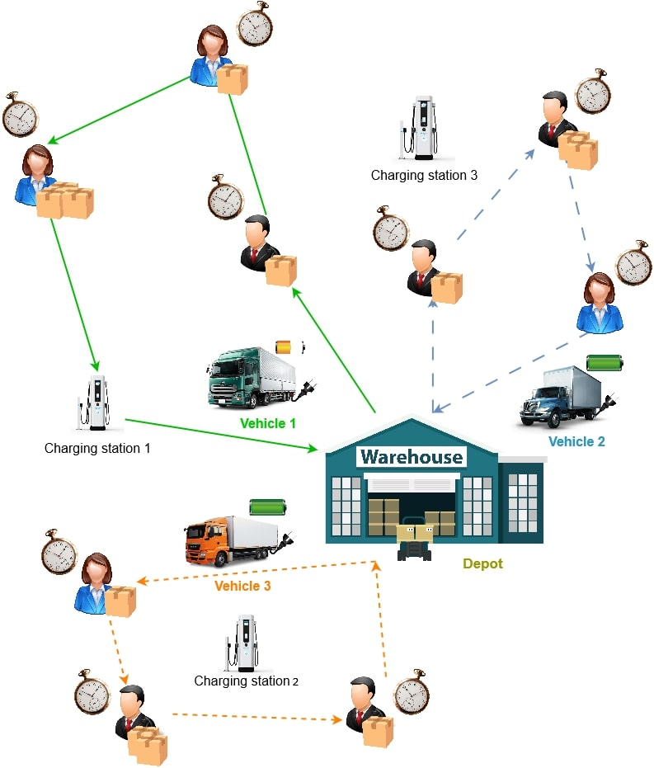
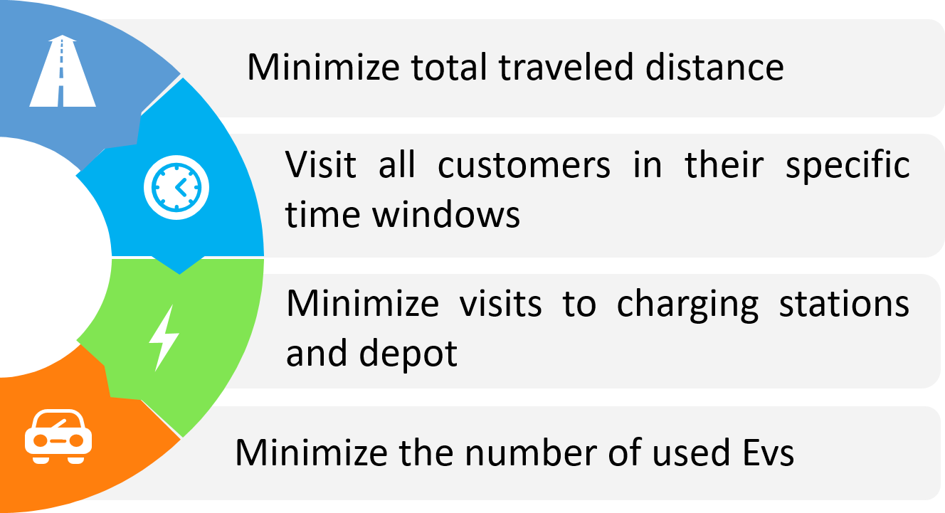
Introduction to Electric Vehicle Routing Problem (EVRP)
Combinatorial Optimization (CO) NP-hard problem that aims to determine the most efficient routes for a fleet of electric vehicles (EVs)
A Variant of VRP
Generalization of Traveler Salesman Problem (TSP)
Notes:
This is where the Electric Vehicle Routing Problem, comes into play.
It’s an Optimization problem that aims to determine the most efficient routes for a fleet of electric vehicles (EVs)
It’s a variant of vehicle routing problem which is a generalization of the TSP problem.
Similarly to VRP we want to visit all destinations, or customers location in the case of commercial fleets, within a minimum total distance
in a specific time window for each customer
Additionally, EVRP considers constraints related to EVs like battery limits and charging station availability.
and if possible to minimize the number of vehicles dispatched
All the references we used are listed at the end of the presentation
—---------------------------------
This growing demand for explainability has sparked interest from researchers in various fields, including transportation field and the common problem of Vehicle Routing.

Slide 6

Gap in research
Comparative analysis to evaluate how different DRL models perform when combined with GNN
Interpretable insights from XAI for EVRP
Combination of DRL, GNN, and XAI
Application of DRL GNN XAI in real world EVRP application
(we own a real world dataset )
Notes:
For this we checked the gap in research and this is what we found:
there is a lack of the integration of XAI for EVRP.
Second, a comparative analysis to evaluate how different DRL models perform to help identify the strengths and weaknesses of each model
has also not been thoroughly explored for the context of EV routing.
Third,the combination of DRL, GNN, and XAI
has not been thoroughly explored, especially in the context of vehicle routing.
And Finally,
many studies remain theoretical so there is a gap in the real-world application

Slide 7
Methodology Overview
Explainable AI (XAI)
03
Deep Reinforcement Learning (DRL)
01
02
Graph Neural Networks (GNN)
Notes:
, our methodology To achieve this is
Initial model development to tackle EVRP using DRL and GNN.
Then
Integration of XAI techniques for interpretability.

Slide 8
Methodology Overview
Explainable AI (XAI)
03
Deep Reinforcement Learning (DRL)
Different DRL models have different strengths and weaknesses
02
01
Graph Neural Networks (GNN)
Evaluate both performance:
How well each model solves EVRP
Interpretability: how well XAI “explains” the model's decisions
Notes:
Different DRL models have different strengths and weaknesses
So We want to
Evaluate both performance:
How well each model solves EVRP
And how well XAI “explains” the model's decisions

Slide 9
Research idea
AI for Sustainability
Evaluate both the optimization performance of each model and their interpretability
Comparative analysis
Comparative analysis of various DRL models combined with GNN and XAI
Scalable & Explainable
Interpretable and optimized solution for EVRP leveraging DRL, GNN, and XAI techniques
Notes:
Our key contributions to this research include:
Interpretable and optimized models for EVRP leveraging DRL, GNN, and XAI techniques
Comparative analysis of these various models
And we evaluate both the optimization performance of each model and their interpretability

Slide 10



Team
 |  | Background | Team Role
Dimeth NOUICER | Tunisia | PhD in Electric-Mobility and RL | Team Lead and Coordinator
Ellie MULAMBA | Democratic Republic of the Congo | PhD in ML and NLP | Evaluation Lead: Define appropriate metrics and track performance
Jérémie N. MABIALA | Democratic Republic of the Congo | Masters in AI Masters in Maths | Technical Lead: Ensures any technical challenges are addressed
Imen HABIBI | Tunisia | Undergraduate engineering student in AI | Model development
Mame Diarra DIOUF | Senegal | Masters student in AI and operational research | Model development
Souleymane DIALLO | Senegal | Undergraduate engineering student in AI | Model development
Notes:
We are a team of 6 members composed of various backgrounds: As the Team Lead, I, Dimeth, recently completed my PhD in E-Mobility and RL,
Which gave me experience with both EVRP and RL
Elie, our Evaluation Lead, is currently pursuing his PhD in ML and NLP.
Jérémie holds two master's degrees in AI and Mathematics.
So With his strong technical background, he will serve as the Technical Lead
We also have Imen, Mame, and Souleymane, who are either master's and undergraduate students specializing in AI.
They will be the driving force behind the development and training of our models, working hands-on to bring our solutions to life

Slide 11
 | Background | Model | Article
Dimeth Nouicer | PhD in E-Mobility and RL | Literature Review and Background Research: key findings, frameworks, and techniques | Writing: Introduction and background Literature review Conclusion and Future Work
Elie Mulamba | PhD in ML and NLP | XAI Integration and Analysis Performance Evaluation and Comparison Study | Writing: XAI and Analysis Results and discussion Paper Review
Jérémie N. MABIALA | Masters in AI Masters in Maths | Methodology and conception: Problem Definition Model selection Architectures to evaluate | Writing: Methods and models Implementation
Imen Habibi | Undergraduate engineering student in AI | RL-GNN Model 1 Implementation and Training
Mame Diarra Diouf | Masters student in AI and operational research | RL-GNN Model 2 Implementation and Training
Souleymane DIALLO | Undergraduate engineering student in AI | RL-GNN Model 3 Implementation and Training
Notes:
Now this is how each member will contribute to the project in terms of model development, research, and article writing.
As the Team Lead, I will focus on literature review and background research
I will also handle the writing of the introduction, background, and conclusion sections of our final article.
Elie, will manage the integration of XAI and conduct performance evaluation and comparison studies of the models.
He will also write the sections covering XAI, analysis, and discussion, as well as oversee the paper review process.
Jérémie will handle methodology and model design, focusing on problem definition, model selection, and evaluating different architectures.
He will also write the methods and model implementation sections of the article.
Meanwhile, Imen, Mame, and Souleymane will be deeply involved in model development.
Each one will focus on implementing and training a combined RL/GNN model

Slide 12
Plan of the idea
Phase | Objective | Tasks | Timeline
1. Project Initialization and Research | Establish a solid understanding of DRL, GNN, and XAI. | - Conduct literature review. - Analyze existing datasets. - Finalize project scope and define problems. | Weeks 1-4
2. Data Preparation | Create a robust dataset for model training, testing, and evaluation. | - Gather real-world data or use publicly available datasets. - Preprocess data. - Generate synthetic data if needed. | Week 1
3. Model Development | Develop DRL and GNN models for EVRP. | - Implement multiple DRL algorithms and GNN architectures. - Integrate models. - Train models for performance optimization. | Weeks 4-present
4. Explainability Integration | Enhance models with XAI features for interpretability. | - Integrate XAI techniques. - Develop methods to explain model decisions. - Test and adjust explainability features. | Weeks 4-present

Slide 13
Organization
Google drive folder to share resources
Trello board to track progress
Whatsapp group for communication

Slide 14
References
[1] Metz C (2017) ‘‘In two moves, AlphaGo and Lee Sedol redefined the future,’’. accessed: 2024-10-15
[2] Metz C (2017) ‘‘How google’s AI viewed the move no human could understand,’’ . 2024-10-15
[3] Cruz F, Young C, Dazeley R, Vamplew P (2022) ‘‘Evaluating human-like explanations for robot actions in reinforcement learning scenarios,’’ In: 2022 IEEE/RSJ International Conference on Intelligent Robots and Systems (IROS), pp. 894–901,IEEE
[4] Dazeley, R., Vamplew, P. & Cruz, F. Explainable reinforcement learning for broad-XAI: a conceptual framework and survey. Neural Comput & Applic 35, 16893–16916 (2023). https://doi.org/10.1007/s00521-023-08423-1
[5] Nouicer, D., Msadaa, I. C., & Grayaa, K. (2023). *A Novel Routing Solution for EV Fleets: A Real-World Case Study Leveraging Double DQNs and Graph-Structured Data to Solve the EVRPTW Problem*. IEEE Access, PP(99):1-1. https://doi.org/10.1109/ACCESS.2023.3327324.
[6] B. Lin, B. Ghaddar and J. Nathwani, "Deep Reinforcement Learning for the Electric Vehicle Routing Problem With Time Windows," in IEEE Transactions on Intelligent Transportation Systems, vol. 23, no. 8, pp. 11528-11538, Aug. 2022, doi: 10.1109/TITS.2021.3105232.
[7] Kool, W., van Hoof, H., & Welling, M. (2019). Attention, Learn to Solve Routing Problems! In International Conference on Learning Representations.
[8] Stephanie Milani, Nicholay Topin, Manuela Veloso, and Fei Fang. 2024. Explainable Reinforcement Learning: A Survey and Comparative Review. ACM Comput. Surv. 56, 7, Article 168 (July 2024), 36 pages. https://doi.org/10.1145/3616864
[9] M. Wang, Y. Wei, X. Huang and S. Gao, "An End-to-End Deep Reinforcement Learning Framework for Electric Vehicle Routing Problem," in IEEE Internet of Things Journal, doi: 10.1109/JIOT.2024.3432911.
[10] Glanois, C., Weng, P., Zimmer, M. et al. A survey on interpretable reinforcement learning. Mach Learn 113, 5847–5890 (2024). https://doi.org/10.1007/s10994-024-06543-w
Notes:
Of course, this presentation is built upon a foundation of existing research.
And These are the references we used

